Slide 1
Heaps

Slide 2
What is a heap
90
Heap is complete binary tree!
Normally implemented as an array
85
85
40
65
55

Slide 3
What is a heap
90
Very fast at insertions and deletions
Very slow at searching!
85
80
40
65
55

Slide 4
Removal
90
55
85
80
85
80
swap
40
65
55
40
65

Slide 5
Removal
85
85
55
80
65
80
Swap
40
65
40
55

Slide 6
Insertion
85
85
65
80
65
80
Swap
40
55
40
55
93

Slide 7
Insertion
85
Swap
93
55
93
55
85
40
65
80
40
65
80

Slide 8
Max-Heapify algorithm
1
s5
16
5
s4
s3
30
27
17
20
s2
s1
2
57
3
90

Slide 9
Max-Heapify algorithm
1
s5
16
5
s4
s3
30
90
17
20
s2
s1
2
57
3
27

Slide 10
Max-Heapify algorithm
1
s5
16
5
s4
s3
57
90
17
20
s2
s1
2
30
3
27

Slide 11
Max-Heapify algorithm
1
s5
16
20
s4
s3
57
90
17
5
s2
s1
2
30
3
27

Slide 12
Max-Heapify algorithm
1
s5
90
20
s4
s3
57
16
17
5
s2
s1
2
30
3
27

Slide 13
Max-Heapify algorithm
1
s5
90
20
s4
s3
57
27
17
5
s2
s1
2
30
3
16

Slide 14
Max-Heapify algorithm
90
s5
1
20
s4
s3
57
27
17
5
s2
s1
2
30
3
16

Slide 15
Max-Heapify algorithm
90
s5
57
20
s4
s3
1
27
17
5
s2
s1
2
30
3
16

Slide 16
Max-Heapify algorithm
90
s5
57
20
s4
s3
30
27
17
5
s2
s1
2
1
3
16

Slide 17
Heap sort
Call Max-Heapify algorithm on a given unsorted array
Swap the first(top) element with the last one
Call sift down method to set top element to its appropriate position
Go to step 2 unless considered range of the list is one element

Slide 18
Heap sort example
15
15
19
10
7
17
16
19
10
7
17
16

Slide 19
Heap sort example
19
19
17
16
7
15
10
17
16
7
15
10

Slide 20
Heap sort example
10
10
17
16
7
15
19
17
16
7
15
19

Slide 21
Heap sort example
17
17
15
16
7
10
19
15
16
7
10

Slide 22
Heap sort example
10
10
15
16
7
17
19
15
16
7
17

Slide 23
Heap sort example
16
16
15
10
7
17
19
15
10
7

Slide 24
Heap sort example
7
7
15
10
16
17
19
15
10
16

Slide 25
Heap sort example
15
15
7
10
16
17
19
7
10

Slide 26
Heap sort example
10
10
7
15
16
17
19
7
15

Slide 27
Heap sort example
10
10
7
15
16
17
19
7

Slide 28
Heap sort example
7
7
10
15
16
17
19
10

Slide 29
Heap sort example
7
7
10
15
16
17
19

Slide 30
Graphs

Slide 31
Terminology
Node = individual components of a network.
Edge = direct link between components
Path = route taken across components to connect two nodes

Slide 32
Terminology. Degree distribution
The degree of a node is the number of connections (or edges) it has coming in from, and going out to, other nodes
1
10
2
3
Node
9
4
10 connections or “edges”
8
5
7
6

Slide 33
Well known graph problems:
Shortest path
Travelling salesman problem
Spanning trees
Graph coloring
Topological sort

Slide 34
Shortest path
What is a shortest path to get from node A to node B?
Build route to travel from Kazan to Berlin which is most optimal in terms of time/hops/cost
Similar problem: All Pair Shortest Path (APSP)

Slide 35
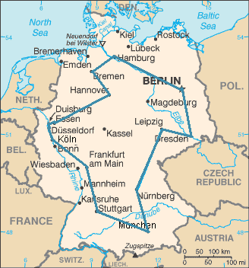
Travelling salesman problem(TSP)
How to visit all points in the fastest way

Slide 36
Minimum spanning tree
What is the minimal number of [roads/links/...] can remain to preserve connections between base points?
Or what is the tree that connects all nodes and has minimum total cost

Slide 37
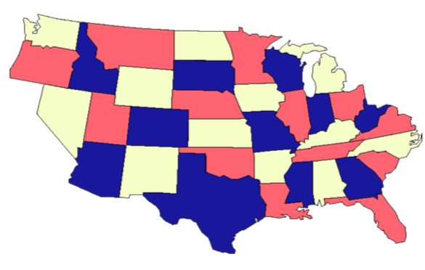
Graph coloring
Given a graph, can it be colored using n colors so that no adjacent nodes have the same color

Slide 38
Topological sort
The vertices can be ordered in such a way that every edge goes from earlier node to the later one

Slide 39
4 things to be good in graphs
Understand graphs
Formalize you problem domain as a graph (special type of graph: oriented, not oriented, weighted, complete, connected, ...)
Implement graphs
Know that there are graph-based algorithms, which can solve your problem

Slide 40
Guess which graph type is suitable for representing given problem
Social network (e.g. friend connections)
Delivery company (e.g. build most cost optimal route of item delivering)
Twitter subscriptions

Slide 41
Graphs representation
Edge list structure
Adjacency list structure
Adjacency matrix structure

Slide 42
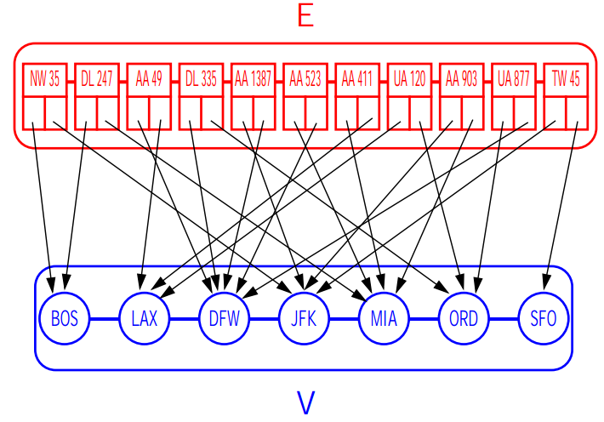
Edge list
The edge list structure simply stores the vertices and the edges into unsorted sequences
Easy to implement
Finding the edges incident on a given vertex is inefficient since it requires examining the entire edge sequence

Slide 43
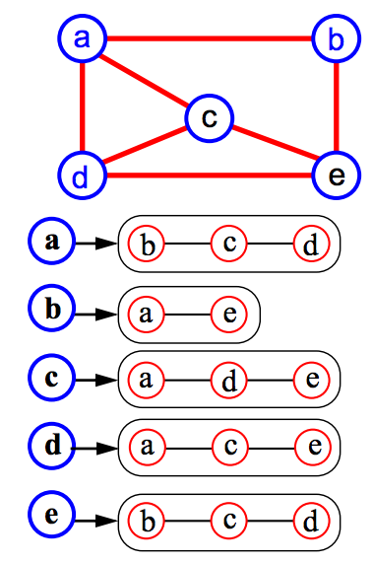
Adjacency list
Adjacency list of vertex v is a sequence of vertices, adjacent to it
Graph is represented by set of such adjacency lists

Slide 44
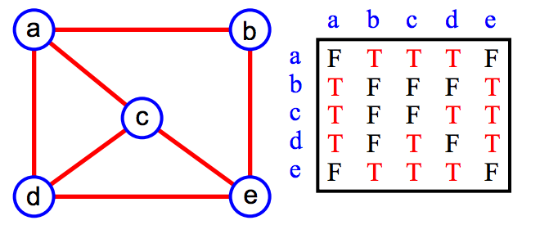
Adjacency matrix
matrix M with entries for all pairs of vertices
M[i,j] = true means that there is an edge (i,j) in the graph
M[i,j] = false means that there is no edge (i,j) in the graph

Slide 45
Task for today
Implement adjacency list structure with methods:
Add vertex
Remove vertex
Add edge
Remove edge
Get adjacent vertices
Write a code that can fill your graph from the following file:
A B C D E F G H Kolya Vasya
A B 5 D Kolya 1 G Kolya 5 Kolya Vasya 12 F B 7
Where first line contains node names separated by spaces, and second line contains triplets of origin, destination and weight for egdes.
Write the code that will serialize graph in the same way.

Slide 46
Task for today
A a = new A(); String astr = serialize(a);
A b = deserialize(astr);
a.equals(b) // by value!!!
a != b // by reference

